Slide 1



Learning Unsupervised
Multi-View Stereopsis
via Robust Photometric Consistency
Tejas Khot Shubham Agrawal Shubham Tulsiani Christoph Mertz Simon Lucey Martial Hebert
Project Page: https://tejaskhot.github.io/unsup_mvs/

Slide 2
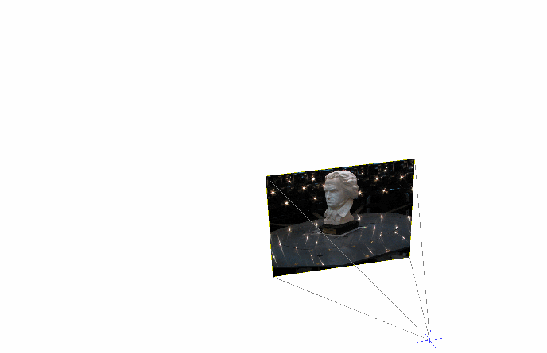
Multi-View Stereopsis
Given:
A set of images
+ camera intrinsics
+ camera extrinsics
Produce:
Geometric representation
of the underlying 3D world
Image source: https://vision.in.tum.de/research/image-based_3d_reconstruction/multiviewreconstruction
Notes:
Source: https://vision.in.tum.de/research/image-based_3d_reconstruction/multiviewreconstruction

Slide 3
Multi-View Stereopsis
Underlying principle:
A 3D point looks locally similar when projected to different viewpoints.
Image source: https://vision.in.tum.de/research/image-based_3d_reconstruction/multiviewreconstruction
Notes:
https://cseweb.ucsd.edu/~shz338/slides/Fall2018_Reading_Group.pdf

Slide 4
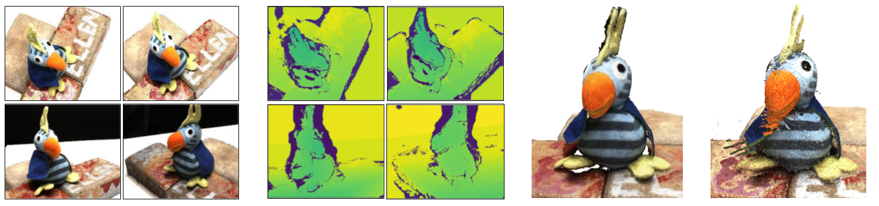
Problem Setup
Input images with known camera extrinsics and intrinsics

Slide 5
Problem Setup
Learned CNN
Depth
Fusion

Slide 6
Problem Setup
Learned CNN
Depth
Fusion

Slide 7
Challenges for learning MVS
}
Unstructured camera geometry
Arbitrary N-Views Input
Generalization to Different Scenes
Q: What is the architecture of the CNN?
Q: What supervision is used to train the CNN?

Slide 8
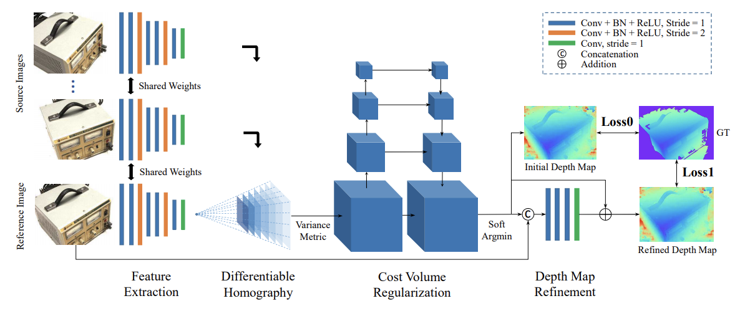
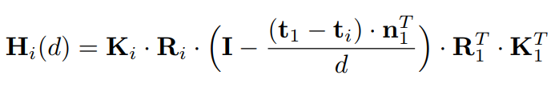
Previous Work: MVSNet
MVSNet: Depth Inference for Unstructured Multi-view Stereo, Yao et al, ECCV 2018

Slide 9

Previous Work: MVSNet
}
Built-in projective geometry
MVSNet: Depth Inference for Unstructured Multi-view Stereo, Yao et al, ECCV 2018

Slide 10
Previous Work: MVSNet
}
Requires
ground truth 3D supervision
}
Built-in projective geometry
MVSNet: Depth Inference for Unstructured Multi-view Stereo, Yao et al, ECCV 2018

Slide 11
Learning Unsupervised
Multi-View Stereopsis

Slide 12
Self-Supervised
Learning Unsupervised
Multi-View Stereopsis

Slide 13
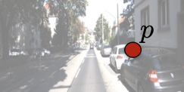
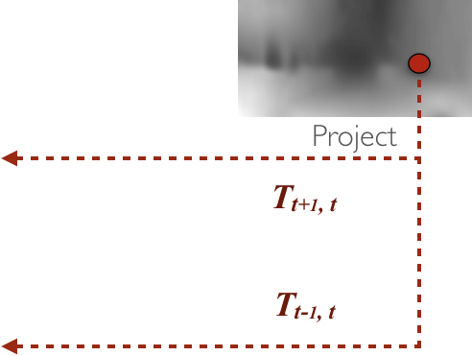
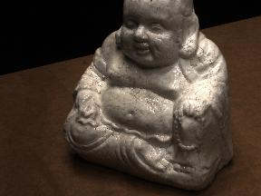
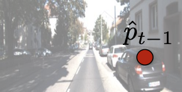
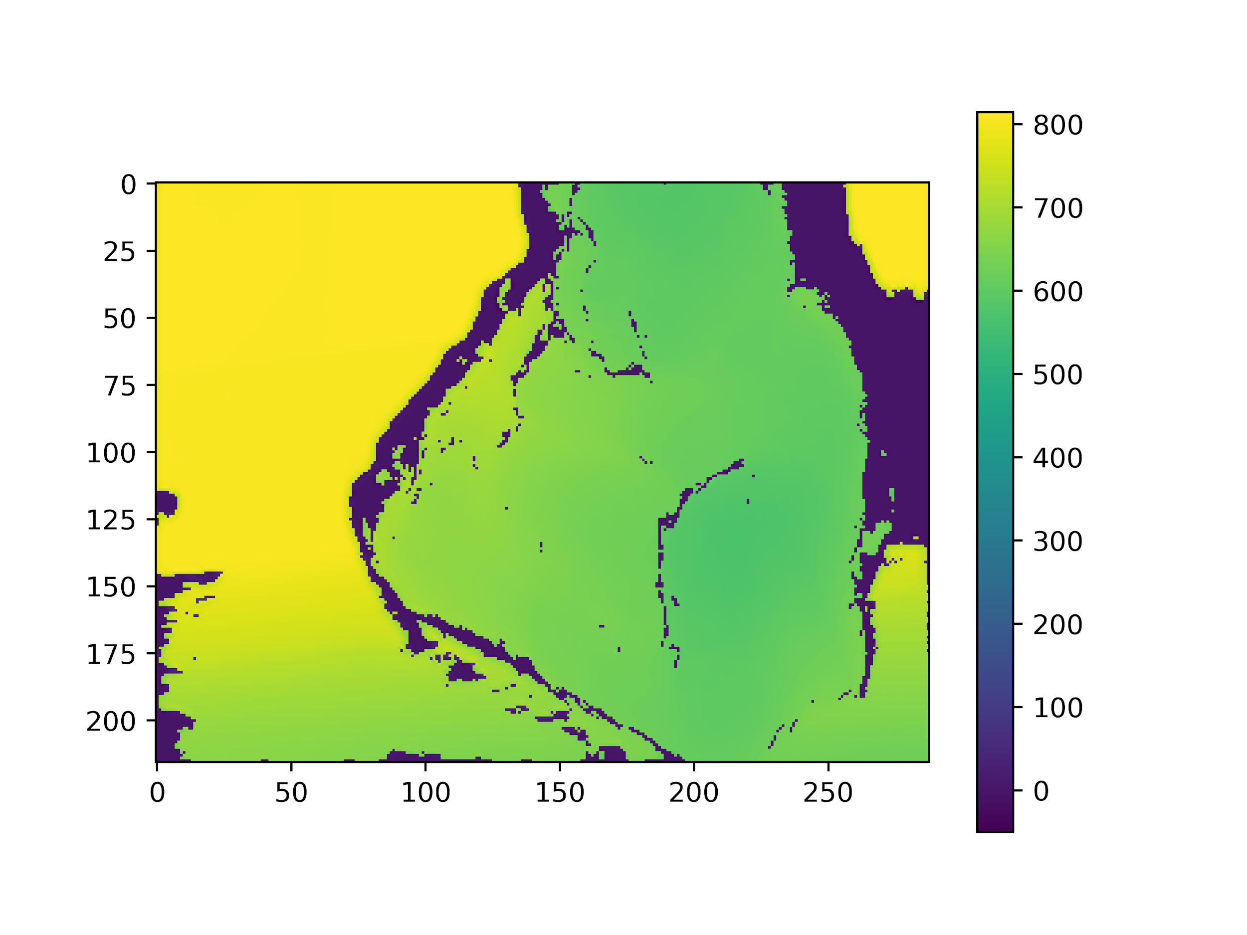
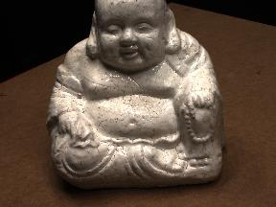
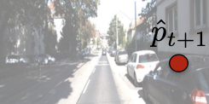
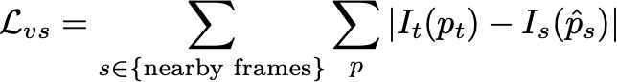
Our Approach
Differentiable homography warp
3D U-Net
N views with known poses
Cost Volume
Depth prediction
Similar architecture to MVSNet
Trained using Photometric Loss
Unsupervised CNN for Single View Depth Estimation: Geometry to the Rescue, Garg et al, ECCV 2016

Slide 14
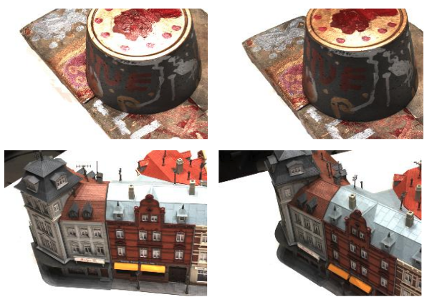
Issues with Photometric Consistency
Lighting Changes - Occlusions - Shadows

Slide 15
Learning Unsupervised
Multi-View Stereopsis
via Robust Photometric Consistency

Slide 16
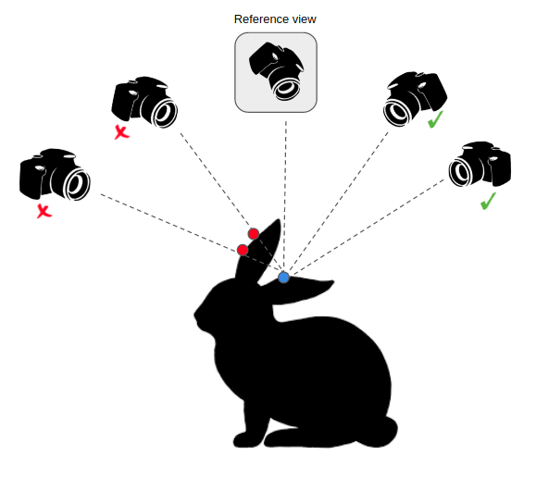
Insight: Only some views can see a point
Enforce selective consistency

Slide 17
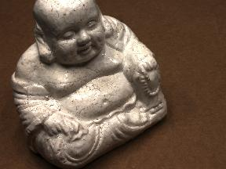
Robust Photometric Loss
W
Reference image
Predicted Depth map
Neighboring view
Pixel-wise
K smallest selection
H x W x M volume
For M neighbors of the reference image
Pixel-wise
error map
W

Slide 18
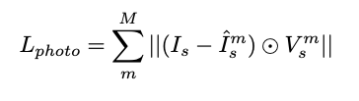
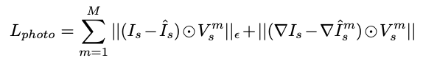
Robust Photometric Loss
First Order Consistency: A cost term saying gradients should match.

Slide 19
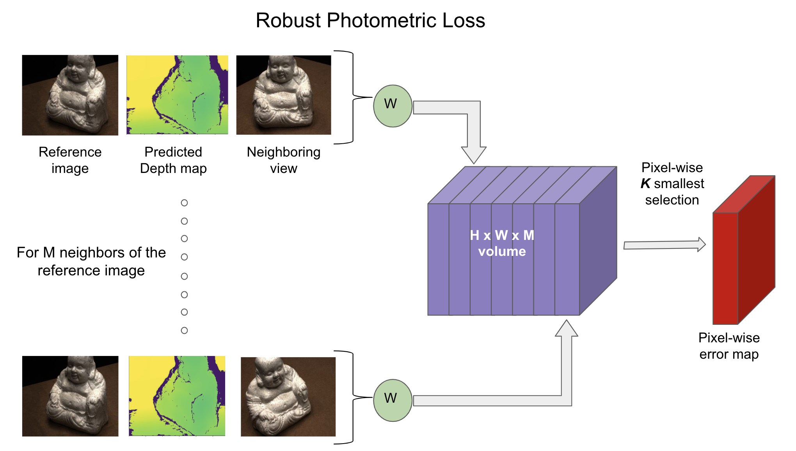
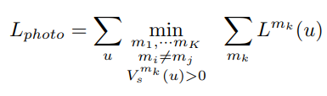
Robust Photometric Loss
First Order Consistency: A cost term saying gradients should match.
Selective Consistency: Each pixel should be consistent with some (not all) views.

Slide 20
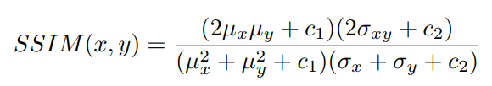
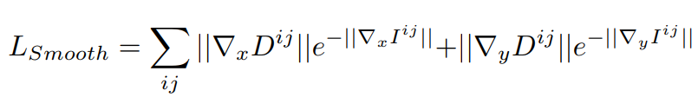
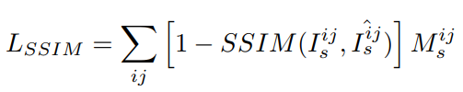
Additional Ingredients
Structured Similarity Loss: Make projected image patches locally similar.
Depth Smoothness Loss: Make depth predictions locally smooth.

Slide 21
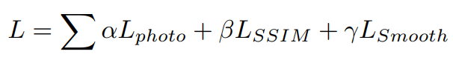
Robust Learning Objective

Slide 22
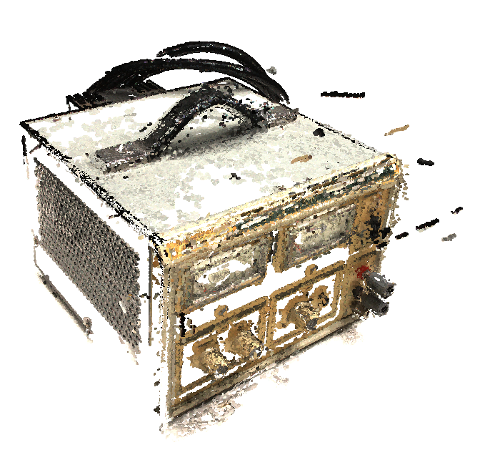
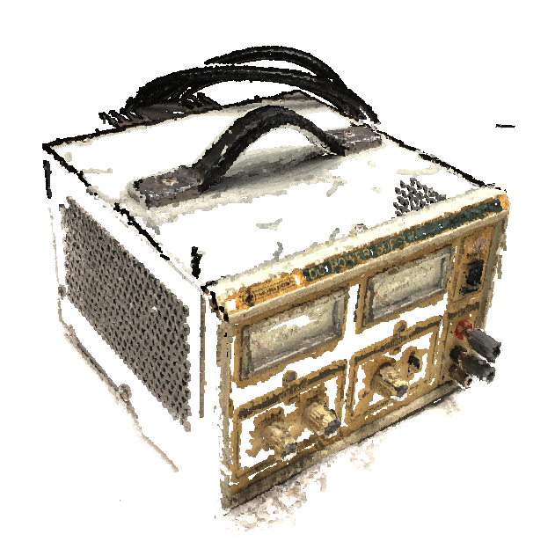
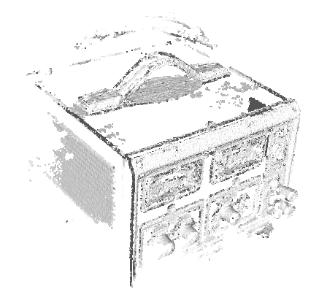
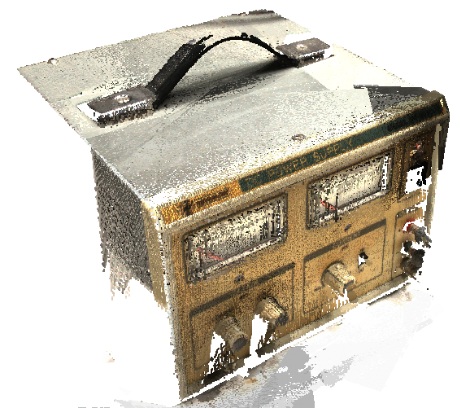
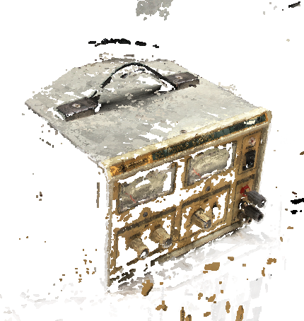
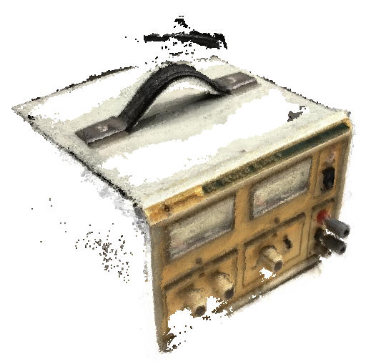
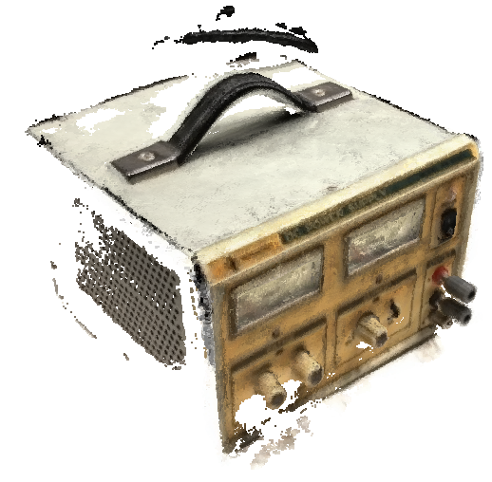
Camp
Furu
Tola
Ground Truth
SurfaceNet
Photometric Baseline
Ours (Robust)
Notes:
Add red rectangles on top to draw attention

Slide 23
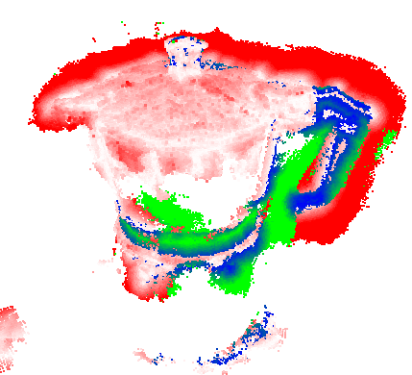
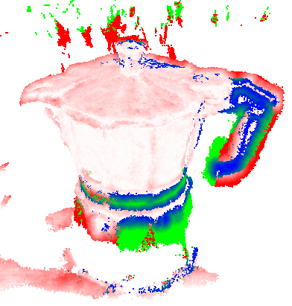
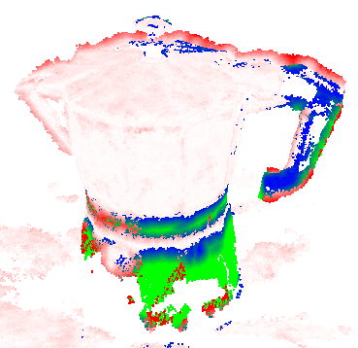
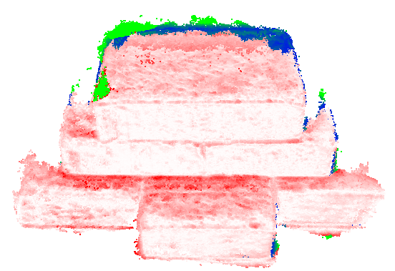
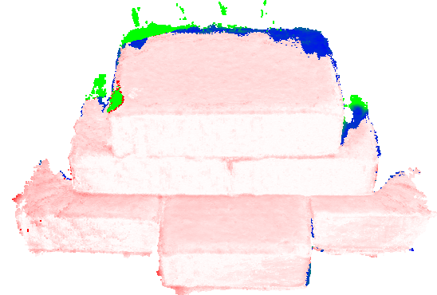
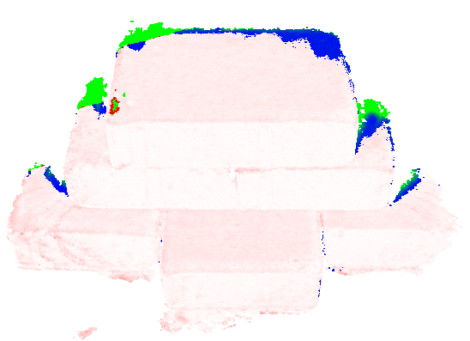
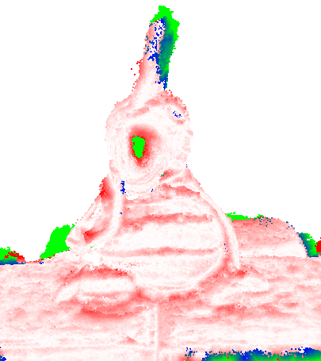
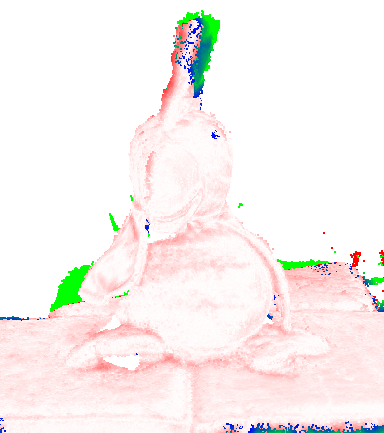
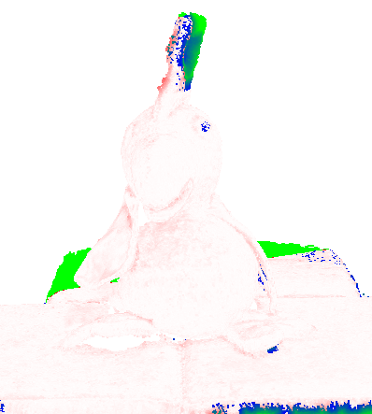
Results on DTU Dataset
Photometric Baseline
Ours (Robust)
MVSNet (Supervised)

Slide 24
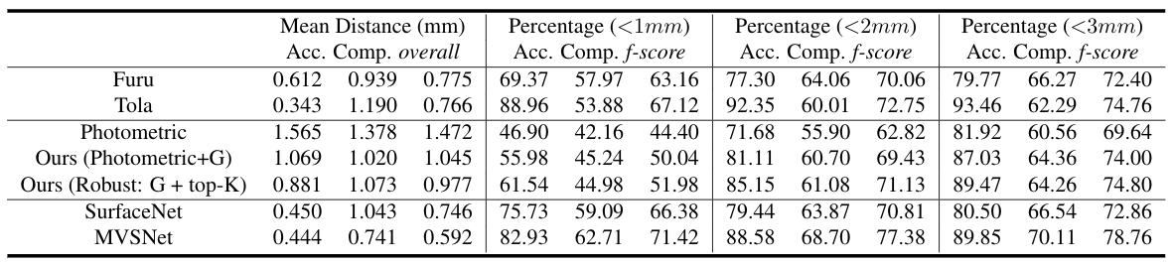
DTU Evaluation
lower is better
Accuracy : mean distance of reconstructed points from the ground truth points
Completeness : mean distance of ground truth points to the reconstructed points
Overall : mean of accuracy and completeness

Slide 25
DTU Evaluation
lower is better
higher is better
Accuracy : mean distance of reconstructed points from the ground truth points
Completeness : mean distance of ground truth points to the reconstructed points
Overall : mean of accuracy and completeness

Slide 26
DTU Evaluation
lower is better
higher is better
Accuracy : mean distance of reconstructed points from the ground truth points
Completeness : mean distance of ground truth points to the reconstructed points
Overall : mean of accuracy and completeness

Slide 27
DTU Evaluation
lower is better
higher is better
Accuracy : mean distance of reconstructed points from the ground truth points
Completeness : mean distance of ground truth points to the reconstructed points
Overall : mean of accuracy and completeness

Slide 28
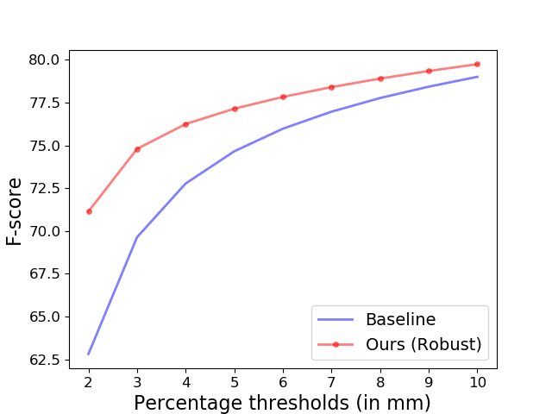
DTU Evaluation

Slide 29
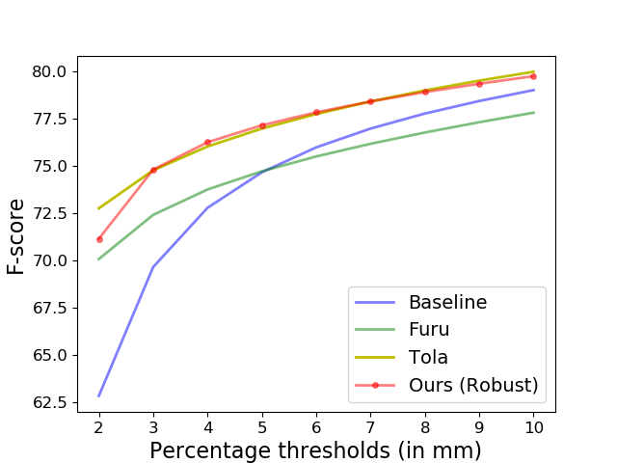
DTU Evaluation

Slide 30
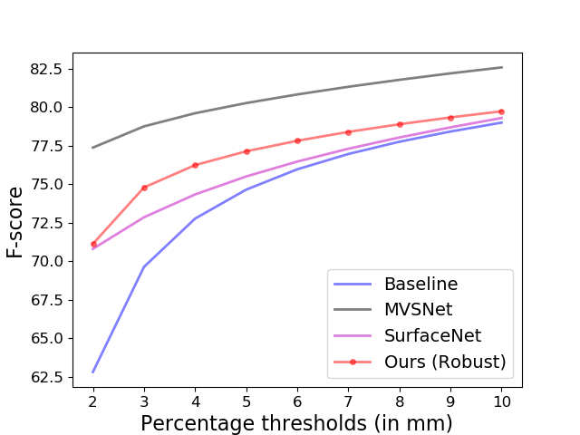
DTU Evaluation

Slide 31
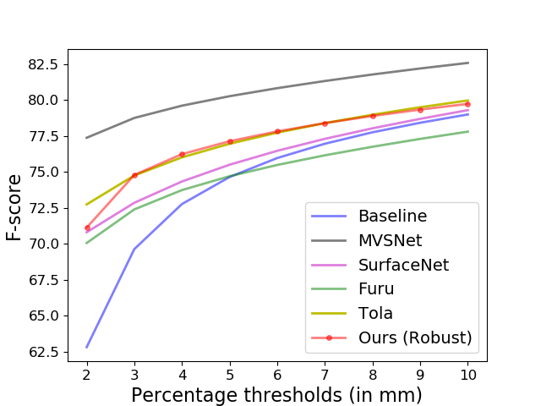
DTU Evaluation

Slide 32
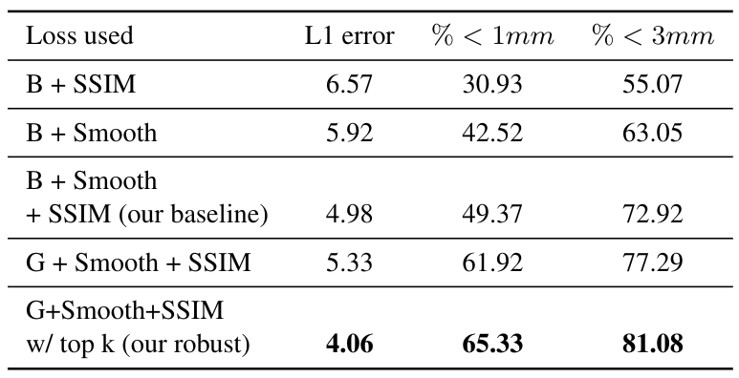
Ablation Studies
Improved performance
Notes:
TODO: add an arrow in the direction top to down with text “improved performance”

Slide 33
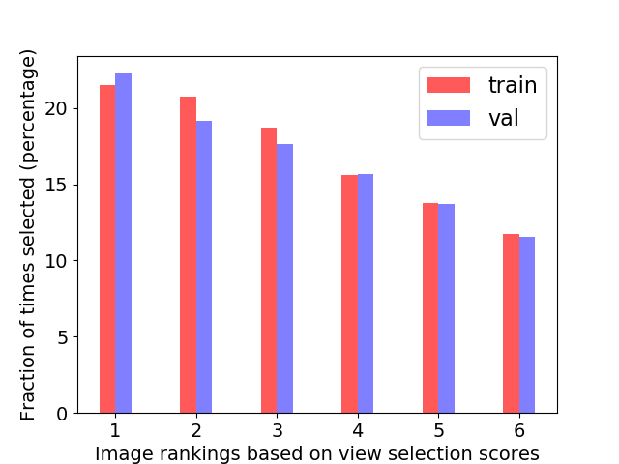
Top-K Frequency

Slide 34
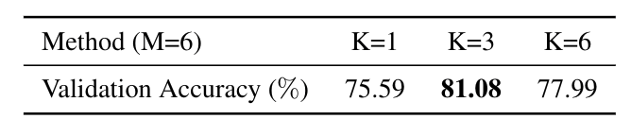
Best performing K value
Results for using best 25%, 50% and 100% of warping losses per-pixel.

Slide 35
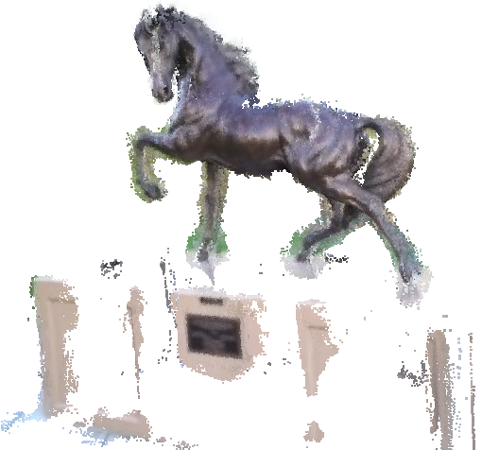
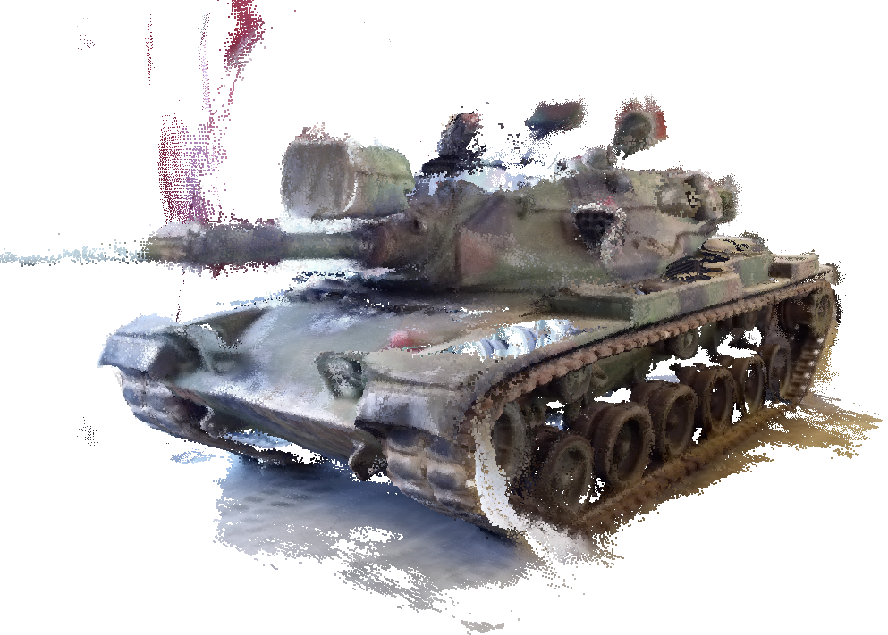
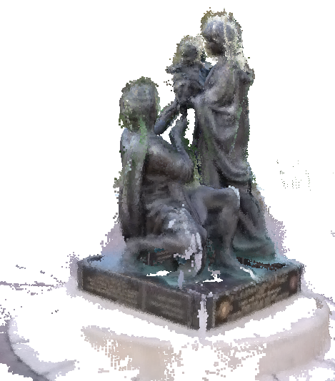


Generalization results on a different dataset: Tanks and Temples
Tanks and temples: benchmarking large-scale scene reconstruction, Knapitsch et al, SIGGRAPH 2017

Slide 36

Generalization results on a different dataset: ETH3D
Fine-tuning using our robust objective
higher is better
A Multi-view Stereo Benchmark with High-Resolution Images and Multi-camera Videos, Schöps et al, CVPR 2017

Slide 37

Thank you
questions?
Project Page: https://tejaskhot.github.io/unsup_mvs/

